Slide 1




Chapter 14: Developing the Sampling Plan

Slide 2

Learning Objectives
Explain the difference between a parameter and a statistic
Explain the difference between a probability sample and nonprobability sample
List the primary types of nonprobability samples
List the primary types of probability samples
Cite 3 factors that influence the necessary sample size
Explain the relationship between population size and sample size
Notes:
Discuss the concept of total sampling elements (TSE)

Slide 3
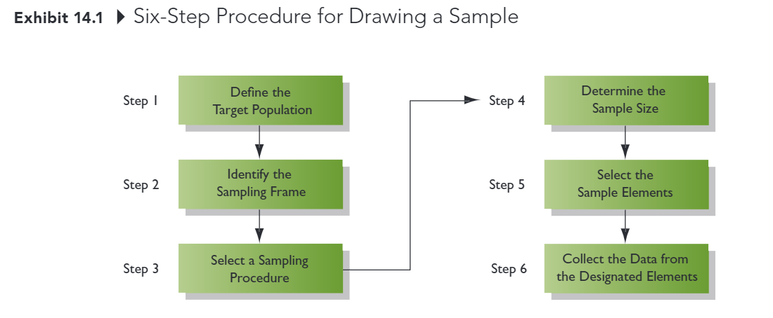
Developing the Sampling Plan

Slide 4
Step 1: Define the Targe Population
Population: All cases that meet designated specifications for membership int eh group
Researchers must be very clear and precise in defining the population
Households in the city limits of Sacramento, CA, with on or more children under the age of 18 living at home.
Census: A type of sampling plan in which data are collected form or about each member of a population
Sample: Selection of a subset of elements from a larger group of objects

Slide 5
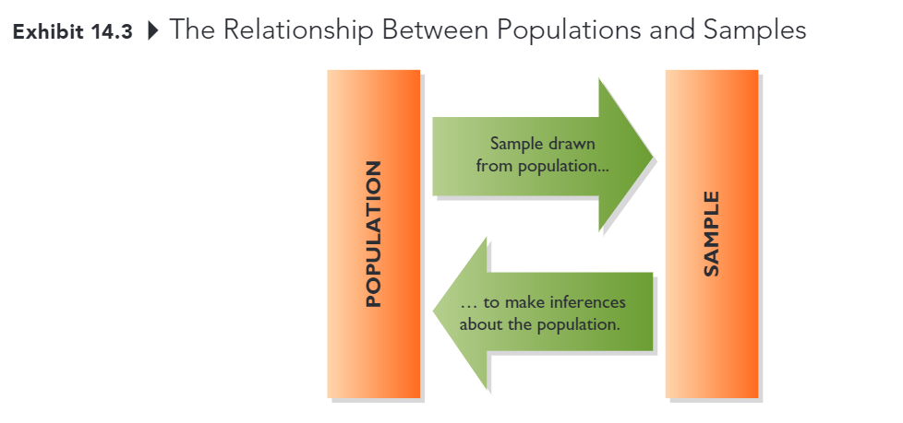
Step 1: Define the Target Population
Parameter: A characteristic or measure of population
Statistic: A characteristic or measure of a sample
We calculate statistics from sample data in order to estimate population parameters

Slide 6
Sampling Error
The difference between results obtained from a sample and results that would have been obtained had information ben gathered form or about every member of the population
Deceased by increasing sample size
Can be estimated (assuming probability sample) usually less torublesoem than other kinds of error

Slide 7
Step 2: Identify the Sampling Frame
Sampling Frame
The list of population elements from which a sample will be drawn; the list could consists of geographic areas, institutions, individuals, or other units
Commonly used sampling frames: customer database, member directories, list developed by data compilers

Slide 8
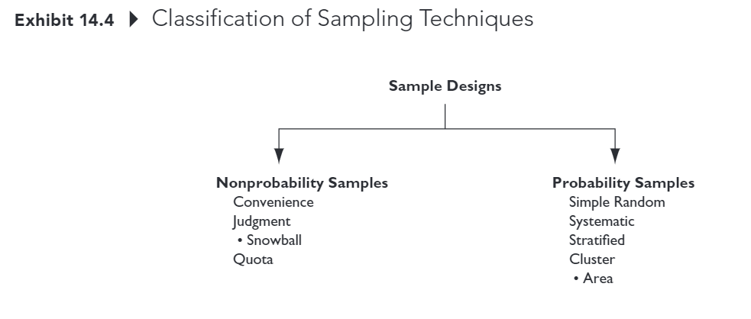
Step 3: Select a Sampling Procedure

Slide 9
Step 3: Select a Sampling Procedure
Nonprobability sample
A sample that relies on personal judgment in the element selection process
With nonprobability samples, sampling error cannot be estimated and we cannot calculate the margin of sampling error
Example:
Convenience
Judgment (e.g., snowball)
Quota

Slide 10
Step 3: Select a Sampling Procedure
Convenience Sample: A nonparaxiality sample in which population elements are included int eh sample because they were readily available
Sometimes referred to as “accidental” sampling; population elements are sampled simply because they are in the right place at the right time
Easy to conduct, but no way to know if sample is representative of the population (i.e., cannot statistically assess sampling error)

Slide 11
Step 3: Select a Sampling Procedure
Judgment Sample: A nonprobability sample in which the sample elements are handpicked because they are expected to serve the research purpose
The researcher may believe that the sample elements are representative of the larger population or that they can offer the information needed
A snowball sample is one form of judgment sample
Notes:
Explain snowball: for example conspiracy group

Slide 12
Step 3: Select a Sampling Procedure
Quota Sample A nonprobability sample chosen so that the proportion of sample elements with certain characteristics is about he same as the proportion of the elements with the characteristics in the target population
A “quota” representing these characteristics is established so that when the sample is complete it will mirror the population on the key characteristics
Notes:
(e.g., 25 males between he ages of 20 and 29; 25 females between the ages of 20 and 29; 35 males between the ages of 30 and 39; etc)

Slide 13
Quota Sampling Example
Research Problem:
Investigate undergraduate student attitudes toward controversial technology fee
Known population parameters class 930% FR, 20% SO, 30% JR, 20% SR) and gender (50% male, 50% female)
10 students will interview 10 friends each
What should be the composition (class and gender) of those 100 students?

Slide 14
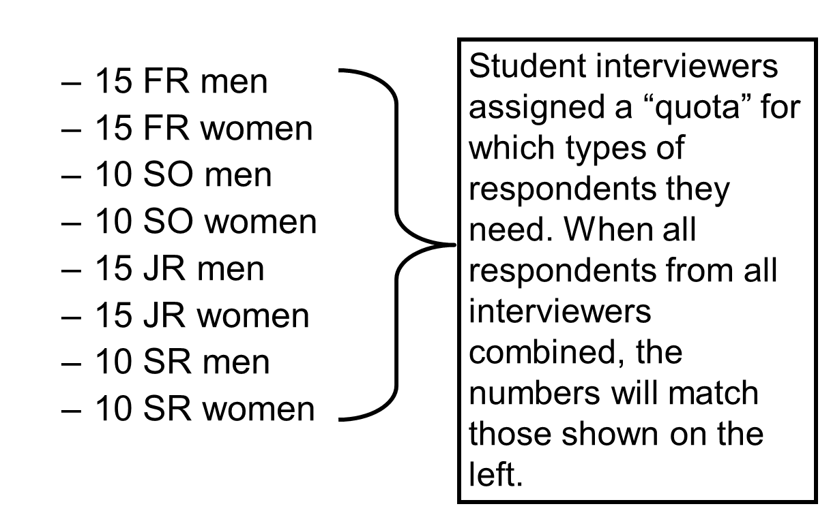
Quota Sampling Example

Slide 15
Probability
Probability Sample: A sample in which each target population element has a known, nonzero chance of being included in the sample
With probability samples there is a random component to which elements are elected; sampling error can be estimated
Simple random
Systematic
Stratified
Cluster (including area)

Slide 16
Why use Probability Sampling?
Because the analyst can statistically assess the level of sampling error and make projections to the population
Just don’t forget that sampling error is only one kind of error and it usually isn’t the biggest problem)

Slide 17
Simple Random Sample
A probability sampling plan in plan in which each unit included in the population has a known and equal chance of being selected for the sample.
If a digital version of the sampling frame is available, implementing a simple random sample is relatively easy

Slide 18
Systematic Sample
Systematic Sample: A probability plana in which every k-th element in the population is selected from the sample pool after a random start
If a digital version of the sampling frame is NOT available, but a list of population members exists, this is a useful approach

Slide 19

Sample Interval Formula
Sampling Interval (k)
The number of population elements to count (k) when selecting the sample members in a systematic sample
$k=\frac{\left\{\#elements in sampling frame\right\}}{\left\{total sampling elements\right\}}$

Slide 20
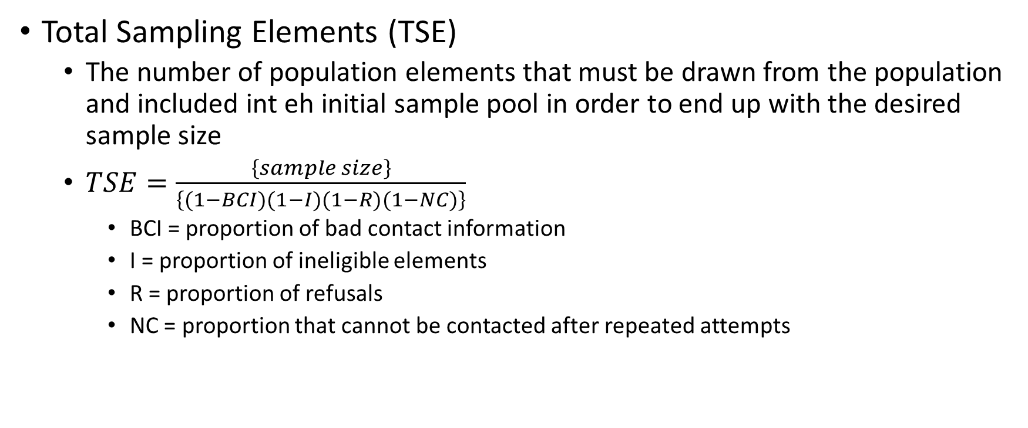
Total Sampling Elements
Total Sampling Elements (TSE)
The number of population elements that must be drawn from the population and included int eh initial sample pool in order to end up with the desired sample size
$TSE=\frac{\left\{sample size\right\}}{\left\{(1−BCI)(1−I)(1−R)(1−NC)\right\}}$
BCI = proportion of bad contact information
I = proportion of ineligible elements
R = proportion of refusals
NC = proportion that cannot be contacted after repeated attempts

Slide 21
TSE Example
You will be conducting a telephone survey of university students who are 21 years of age or older. You have determined that a sample size of 250 will allow reasonable precision and confidence for your estimates of important population parameters. Let’s assume that 15% of the telephone numbers aren’t working, 2% of students you contact are ineligible because they have working telephone numbers but have left the school, about 20% of students will refuse to participate, and you will be unable to reach 30% of those selected for the sample (BCI=0.1, I=0.02, R=0.20, NC=0.30).
How many sampling elements should you include in the project?

Slide 22
Systematic Sampling Example
Knowing that you need a sample pool of 536 students to ultimately get about 250 students in your sample, you are in position to draw a systematic sample form the student directory at your university. Further, 5,000 students are listed in the directory
What is the sampling interval?

Slide 23

Systematic Sampling Example
$K=\frac{\left\{\#elements in sampling frame\right\}}{\left\{total sampling elements\right\}}=\frac{5000}{536}=9.3$
Randomly select one of the first 9 students and select every 9th students after to be in the initial sampling pool

Slide 24
Stratified Sample
A probability sample in which
(1) the population is divided into mutually exclusive and exhaustive subsets
A probabilistic sample of elements is chosen independently from each subset
Most appropriate when strata are homogeneous within but heterogenous between with respect to key variable(s)
Decreased variance within strata on key variable(s) means increased precision
Ability to ensure that important strata are represented

Slide 25
Cluster Sample
A probability sample in which
(1) the parent population is divided into mutually exclusive and exhaustive subsets
(2) a random sample of one or more subsets (clusters) is selected
Strata should be heterogeneous within, homogeneous between
An AREA SAMPLE is a form of cluster sampling in which areas (e.g., census tracts, blocks) serve as the primary sampling units

Slide 26
Step 4: Determine the Sample Size
To determine the necessary sample size, we need 3 pieces of info:
How homogeneous (similar) the population is on the characteristic to be estimated
How much precision is needed in the estimate
How confident we need to be that the true value falls within the precision range established
Precision: the degree of error in an estimate of a population parameter
Confidence: the degree to which one can feel confident that an esitamte approximates the true value
Precision and confidence are inversely related: as one increases, the other decreases, all else equal

Slide 27
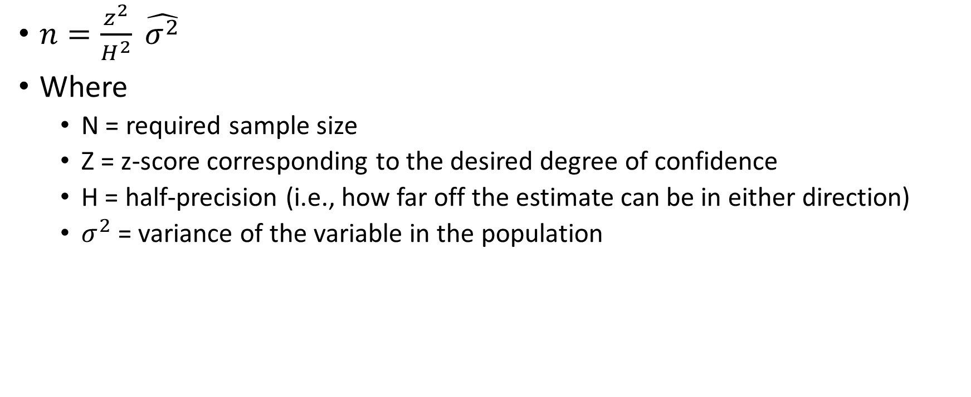
Determining Sample Size when Estimating Means
$n=\frac{z^{2}}{H^{2}} \hat{σ^{2}}$
Where
N = required sample size
Z = z-score corresponding to the desired degree of confidence
H = half-precision (i.e., how far off the estimate can be in either direction)
$σ^{2}$ = variance of the variable in the population

Slide 28
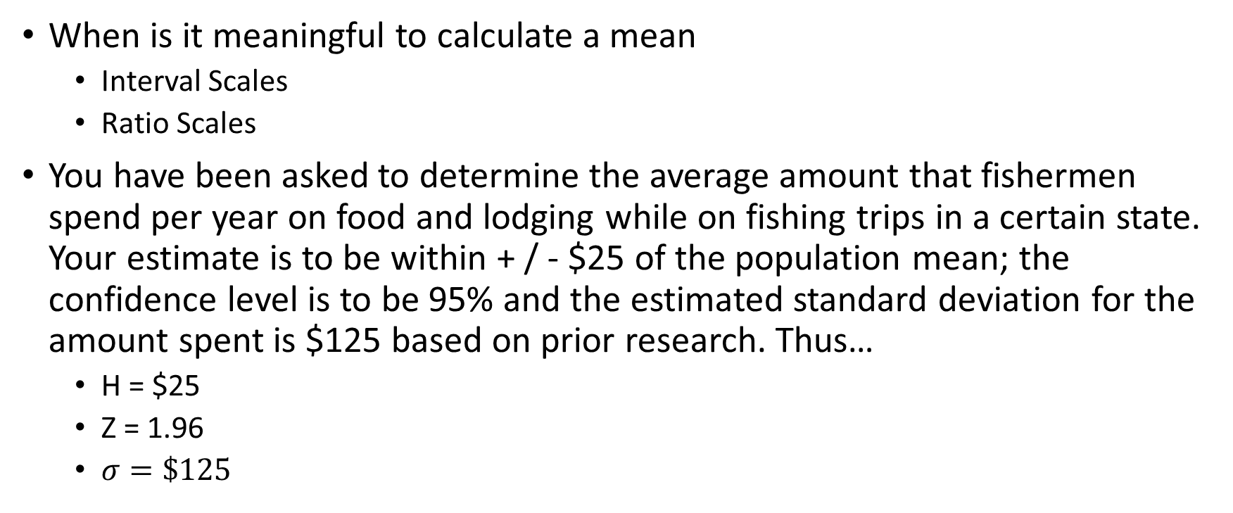
Determining Sample When Estimating Means
When is it meaningful to calculate a mean
Interval Scales
Ratio Scales
You have been asked to determine the average amount that fishermen spend per year on food and lodging while on fishing trips in a certain state. Your estimate is to be within + / - $25 of the population mean; the confidence level is to be 95% and the estimated standard deviation for the amount spent is $125 based on prior research. Thus…
H = $25
Z = 1.96
$σ=\$125$

Slide 29

Determining Sample When Estimating Means
How large a sample do you need?
$n=\frac{z^{2}}{H^{2}}\left(\hat{σ^{2}}\right)=\frac{{1.96}^{2}}{{25}^{2}}{125}^{2}=96$

Slide 30
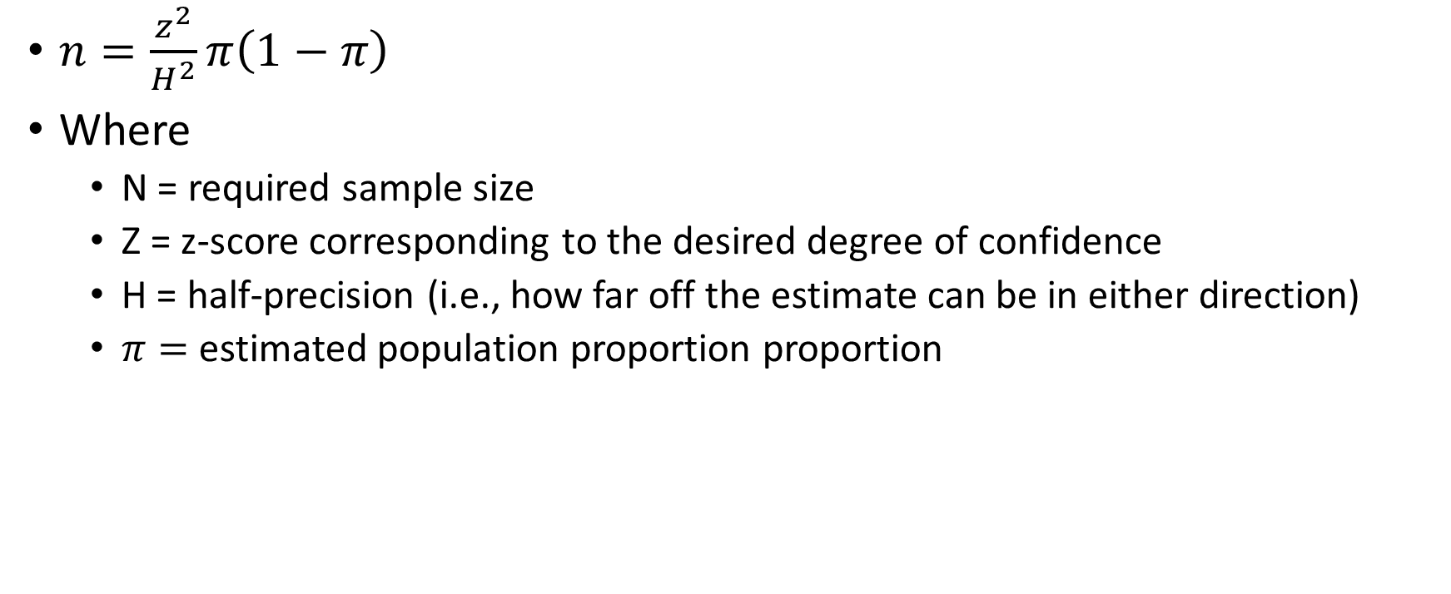
Determining Sample When Estimating Proportions
$n=\frac{z^{2}}{H^{2}}π\left(1−π\right)$
Where
N = required sample size
Z = z-score corresponding to the desired degree of confidence
H = half-precision (i.e., how far off the estimate can be in either direction)
$π=$estimated population proportion proportion

Slide 31
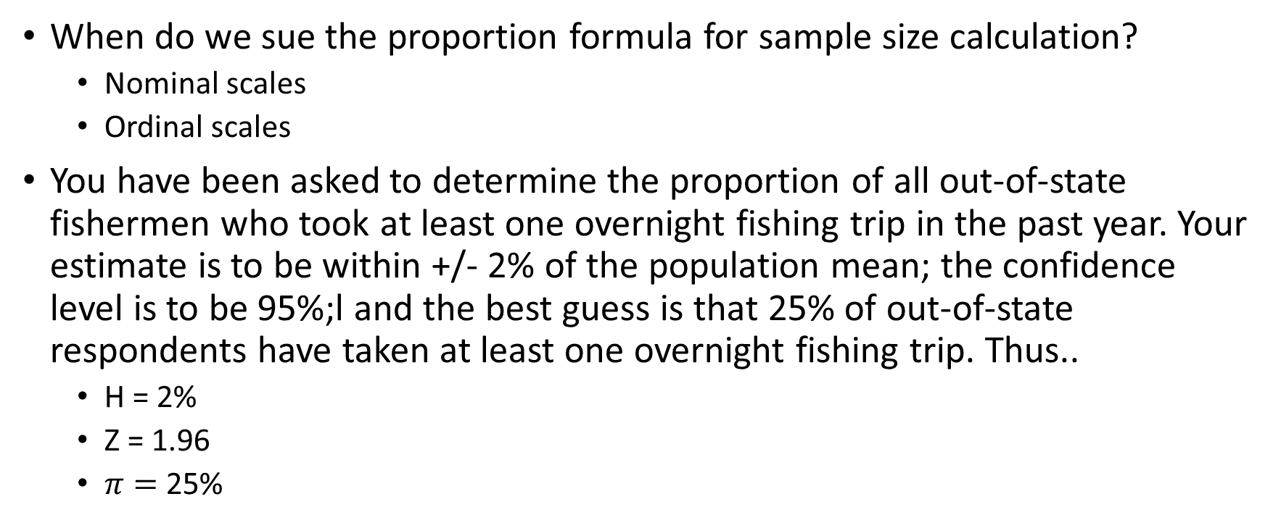
Determining Sample When Estimating Means
When do we sue the proportion formula for sample size calculation?
Nominal scales
Ordinal scales
You have been asked to determine the proportion of all out-of-state fishermen who took at least one overnight fishing trip in the past year. Your estimate is to be within +/- 2% of the population mean; the confidence level is to be 95%;l and the best guess is that 25% of out-of-state respondents have taken at least one overnight fishing trip. Thus..
H = 2%
Z = 1.96
$π=$25%

Slide 32

Determining Sample When Estimating Means
How large a sample do you need?
$n=\frac{z^{2}}{H^{2}}π\left(1−π\right)=\frac{{1.96}^{2}}{{0.02}^{2}}.25\left(1−.25\right)=1800$

Slide 33
Population Size and Sample Size
Unless the sample will be more than 5-10% of the population size, the size of the population does not enter into the calculation of the size of the sample
Many people, including managers, have trouble with this idea.

Slide 34

Finite Population Sample Size
For use when sample size > 10% of the population size
For means: $n=\frac{\left\{σ^{2}\right\}}{\left\{\frac{H^{2}}{Z^{2}}+\frac{σ^{2}}{N}\right\}}$
For proportions: $n=\frac{\left\{π\left(1−π\right)\right\}}{\left\{\frac{H^{2}}{Z^{2}}+\frac{π\left(1−π\right)}{N}\right\}}$

Slide 35
Other approaches to determining sample size
Size of research budget
Anticipated analyses
Historical practice
Notes:
But these methods are rather unscientific and based largely on human intuition (which is flawed)

Slide 36
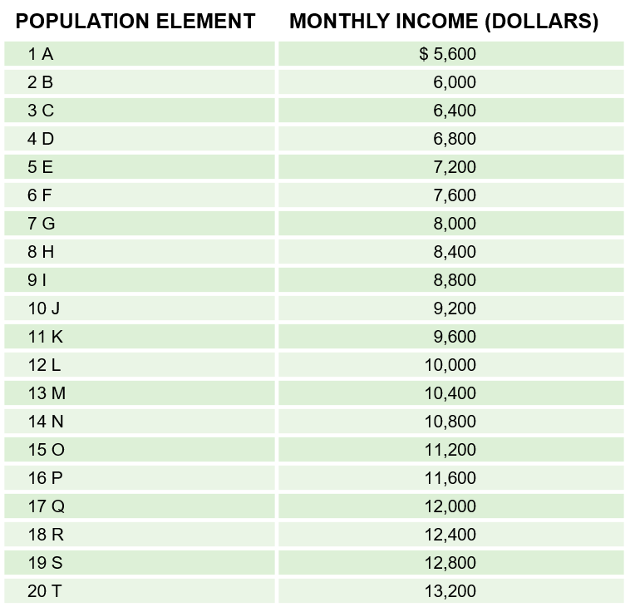
Basics of the Sampling Distribution
EXHIBIT 14A.1 Population
Population Mean (μ) = $9400

Slide 37
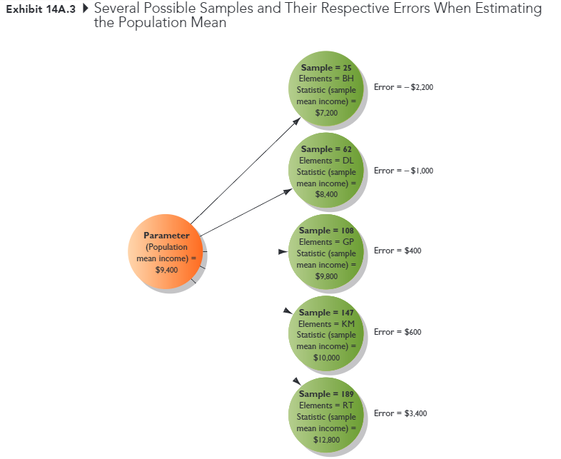
Basics of the Sampling Distribution
Derived population
All possible sample that can be drawn from the population under a given sampling plan

Slide 38
Basics of the Sampling Distribution
The mean of all possible sample means is equal to the population mean
The variance of the sample means is related to the population variance
The sampling distribution is mound shaped
Consistent with the Central-Limit Theorem, regardless of the shape of the distribution of the variable in the population, with a sample size of 30, the distribution of sample means becomes normally distributed

Slide 39
Chapter 15: Data Collection: Enhancing Response Rates while Limiting Errors

Slide 40
Learning Objectives
Describe the 6 types of error that can enter a study
Give the general definition for response rate
Discuss several ways in which response rates might be improved

Slide 41
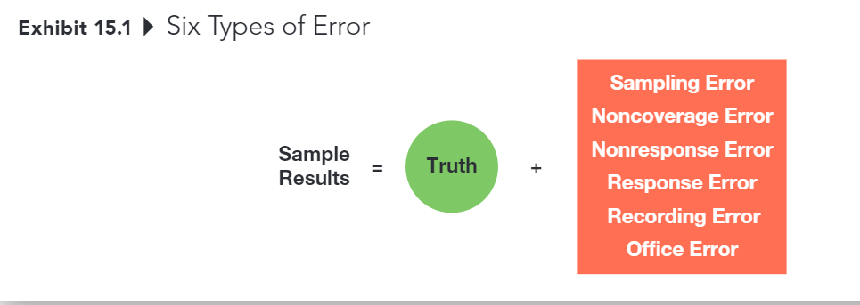
Six Types of Error

Slide 42
Six Types of Error
Sampling Error
The difference between results obtained from a sample and results that would have been obtained had info been gathered from or about every member of the population
Decreased by increasing sample size
Can be estimated (assuming probability sample)
Usually less trouble some than other kinds of error
However, sampling error usually isn’t the biggest problem – it’s all the other things that contribute error to a project.
And these other sources of error can’t be accounted for statistically …

Slide 43
Six Types of Error
Noncoverage Error
Error that arises because of failure to include qualified elements of the defined population in the sampling frame
Noncoverage error is essentially a sampling frame problem

Slide 44
Six Types of Error
Error from failing to obtain info from some elements of the population that were selected and designated for the sample
This is potential problem that only occurs when those who respond are systematically different in some important way from those who don’t respond

Slide 45
Six Types of Error
Suppose that a university wanted to assess the success of its graduates, based on their annual salaries, 5 years after graduation
Which graduates are more likely to return a survey? (Those who are happy with their salaries)
Which graduates are less likely to return a survey? (those who are not happy with their salaries)

Slide 46
Primary Sources of Nonresponse Error
Refusals
Not-at-Homes
Notes:
It’s better to work hard at generating responses from a smaller sampling pool than to start with a much larger sampling pool and ignore potential nonresponse error, even if the resulting sample size is smaller
Pay attention to the response rates delivered by different online panel companies. The completion rate is not the same thing as the overall response rate!

Slide 47
3 Methods for Diagnosing Nonresponse Error
Contact a sample of nonrespondents
Compare respondent demographics against known demographics of population
Conduct an analysis of late responders vs. early responders (this method is very controversial)

Slide 48
Six Types of Error
Response Error
Error that occurs when an individual provides an inaccurate response, consciously or subconsciously, to a survey item
Key considerations:
Does the respondent understand the question?
Does the respondent know the answer to the question?
Is the respondent willing to provide the true answer to the question?
Is the wording of the question or the situation in which it is asked likely to bias the response
Notes:
Source: Weiers (1988)

Slide 49
Six Types of Error
Office Error
Error due to data editing, coding , or analysis errors

Slide 50
Total Error is the Key
The goal is to decrease overall error, not any one source of error
Sampling Error
Noncoverage Error
Nonresponse Error
Response Error
Office

Slide 51
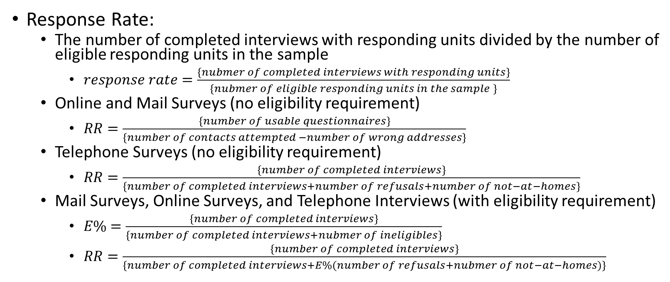
Calculating Response Rates
Response Rate:
The number of completed interviews with responding units divided by the number of eligible responding units in the sample
$response rate=\frac{\left\{nubmer of completed interviews with responding units\right\}}{\left\{nubmer of eligible responding units in the sample \right\}}$
Online and Mail Surveys (no eligibility requirement)
$RR=\frac{\left\{number of usable questionnaires\right\}}{\left\{number of contacts attempted −number of wrong addresses\right\}}$
Telephone Surveys (no eligibility requirement)
$RR=\frac{\left\{number of completed interviews\right\}}{\left\{number of completed interviews+number of refusals+number of not−at−homes\right\}}$
Mail Surveys, Online Surveys, and Telephone Interviews (with eligibility requirement)
$E\%=\frac{\left\{number of completed interviews\right\}}{\left\{number of completed interviews+nubmer of ineligibles\right\}}$
$RR=\frac{\left\{number of completed interviews\right\}}{\left\{number of completed interviews+E\%(number of refusals+nubmer of not−at−homes)\right\}}$

Slide 52
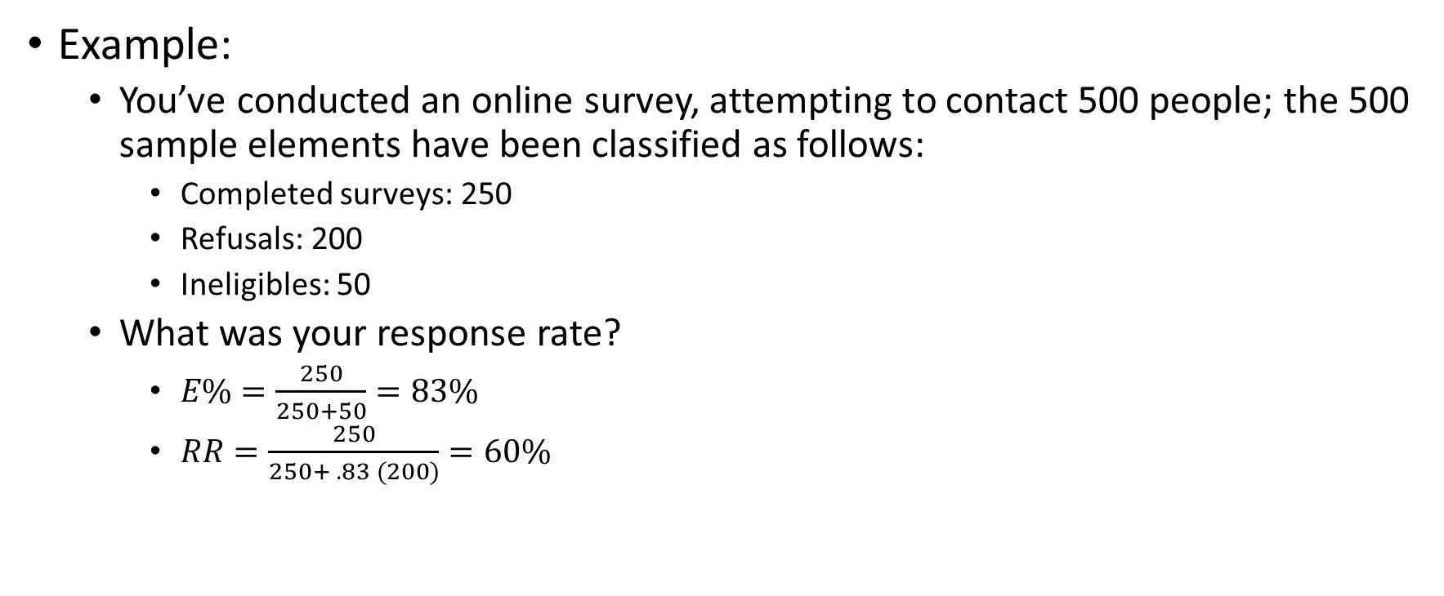
Calculating Response Rates
Example:
You’ve conducted an online survey, attempting to contact 500 people; the 500 sample elements have been classified as follows:
Completed surveys: 250
Refusals: 200
Ineligibles: 50
What was your response rate?
$E\%=\frac{250}{250+50}=83\%$
$RR=\frac{250}{250+ .83 (200)}=60\%$

Slide 53
Improving Response Rates
The response rate on a project serves as an indicator of the overall quality of a data collection effort. It also provides insight into the likely influence of nonresponse error on the project
Researchers must strive to obtain the highest response rates possible in a given situation

Slide 54
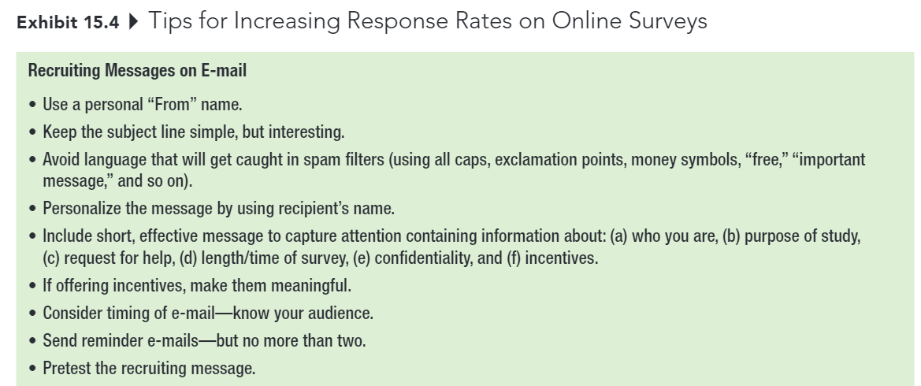
Improving Response Rates

Slide 55
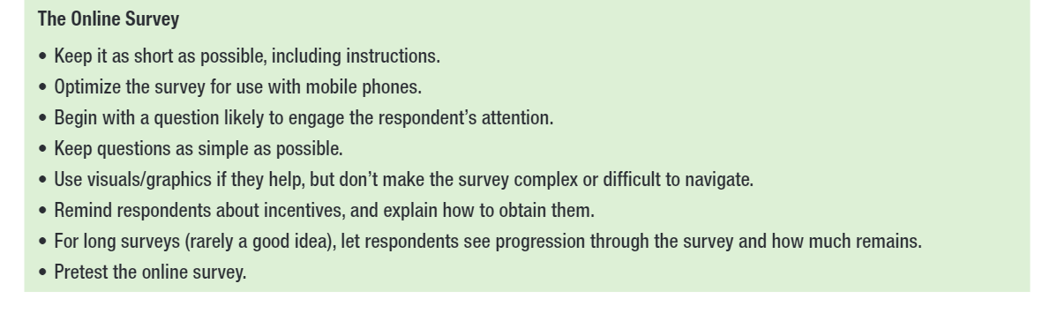
Improving Response Rates

Slide 56
Improving Response Rates
Respondent interest in topic
Survey length
Guarantee of confidentiality or anonymity
Interviewer characteristics and training
Personalization
Response incentives
Follow-up surveys

Slide 57
First Exam
Chapters 8 to 15, with a heavy emphasis on chapters 8, 12, and 15
Please review my slides (especially iClicker questions).
25 questions (200 points) with 2 extra credit questions (16 points) in 75 mins
Notes are allowed
Lockdown Browser is required
1 attempt only
Online
Notes:
You can either take it wherever you want. However, I strongly encourage you to come to class with your laptop to take the exam. I will be in class to answers any questions if you have during the exam. But I can’t answer it if you are elsewhere, so keep it in minds.
It will be open from 7: 55 AM to 9:30 AM on October 11th.

